Slide 1
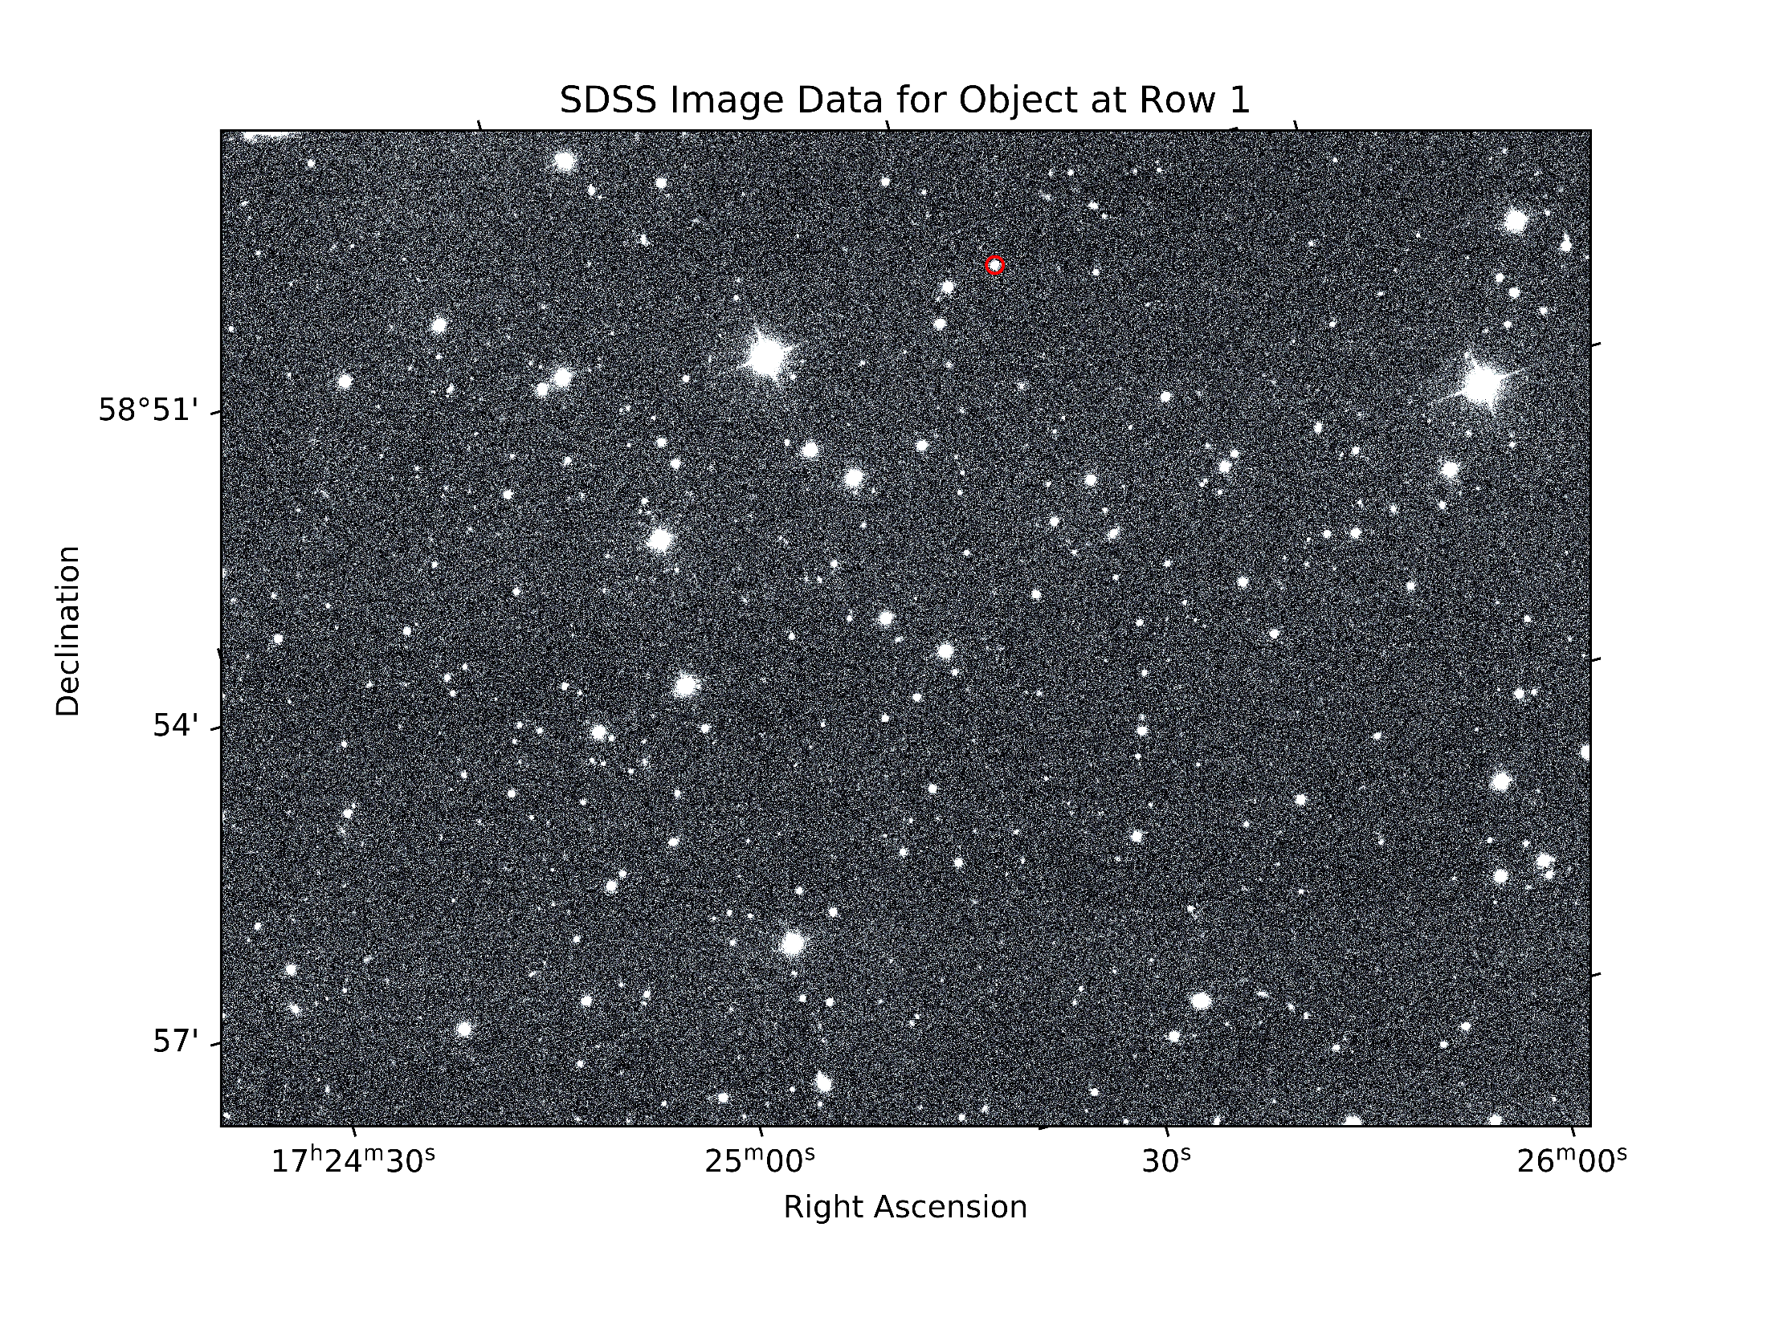
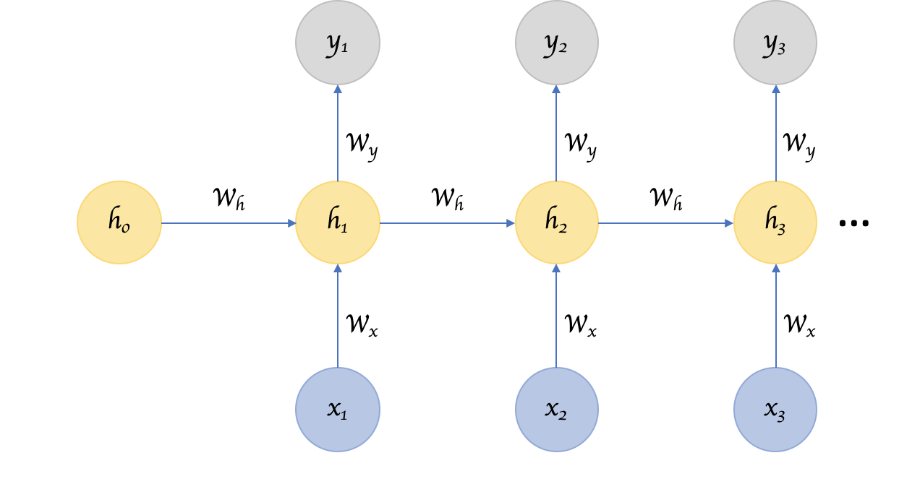
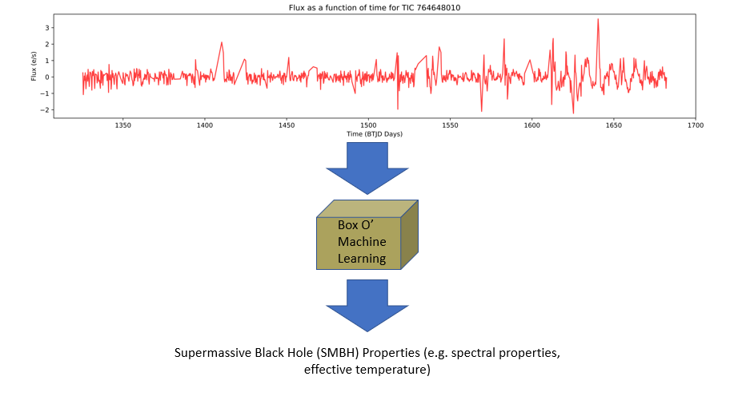
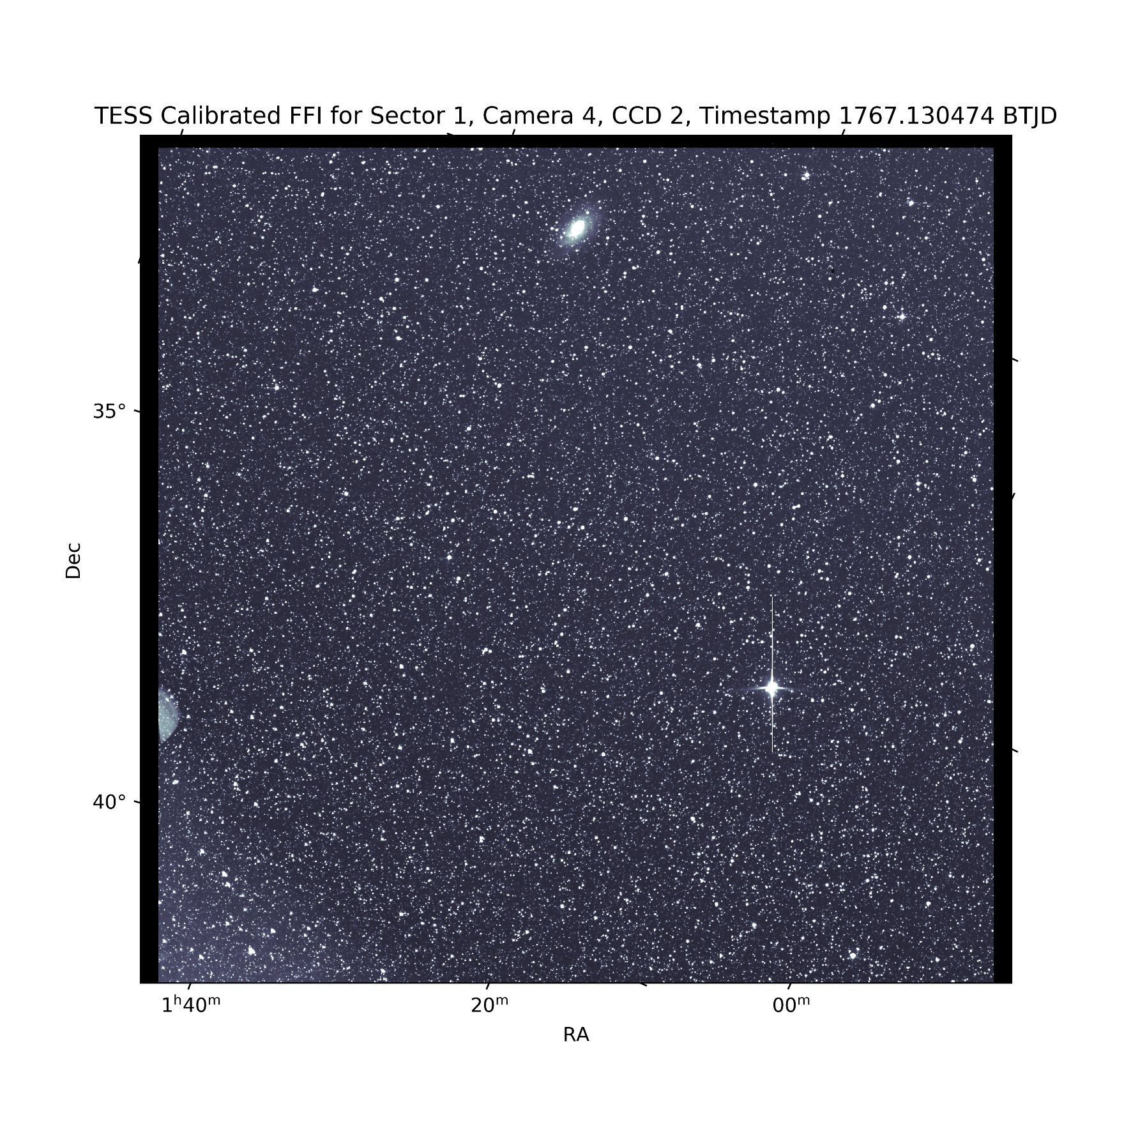
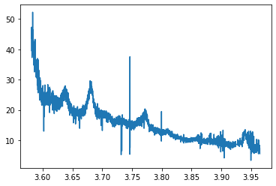
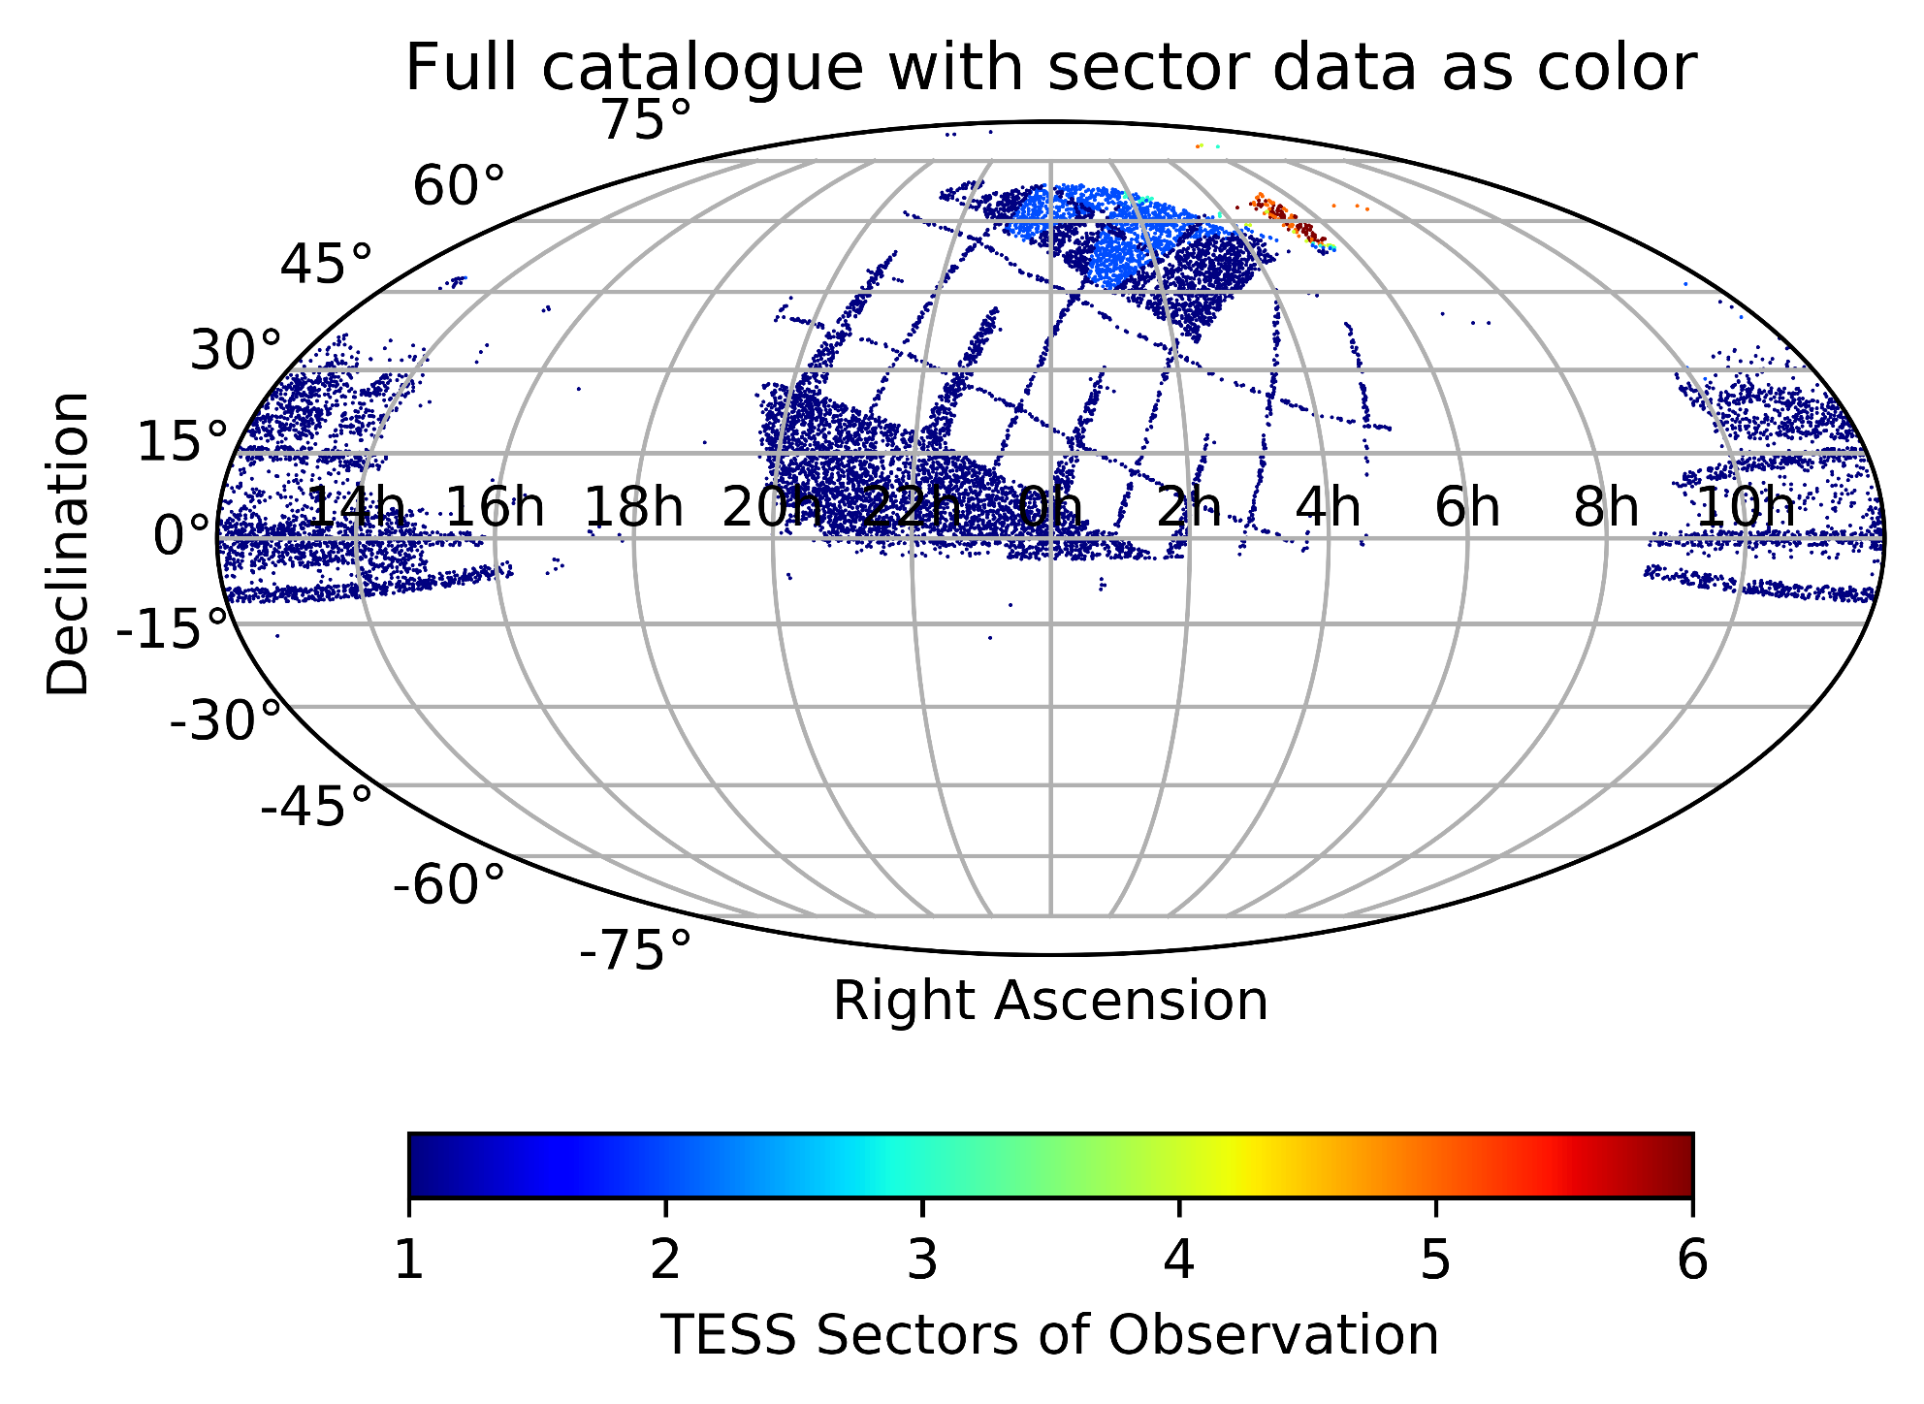
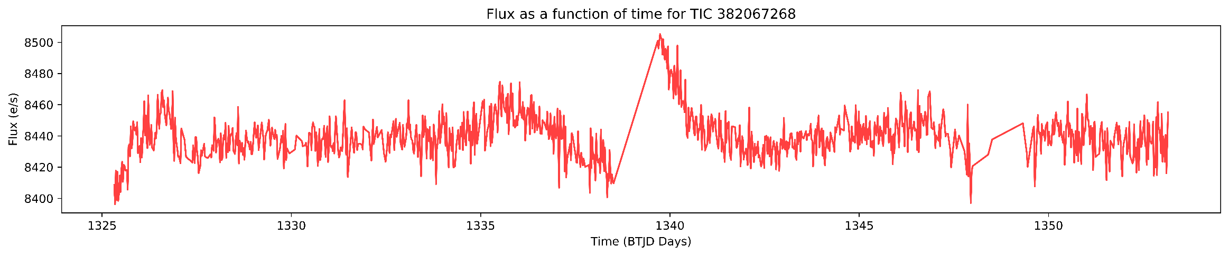
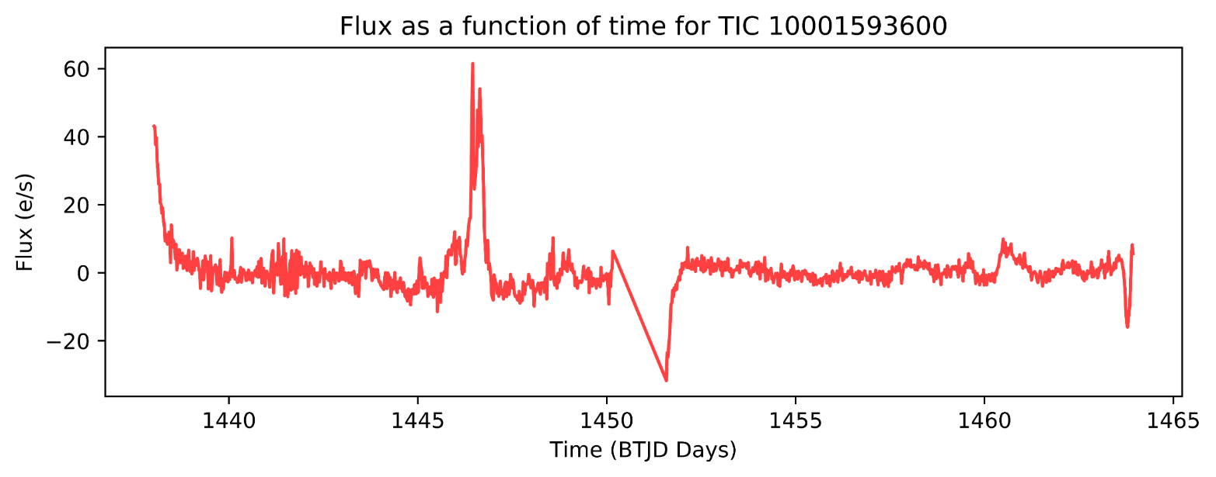
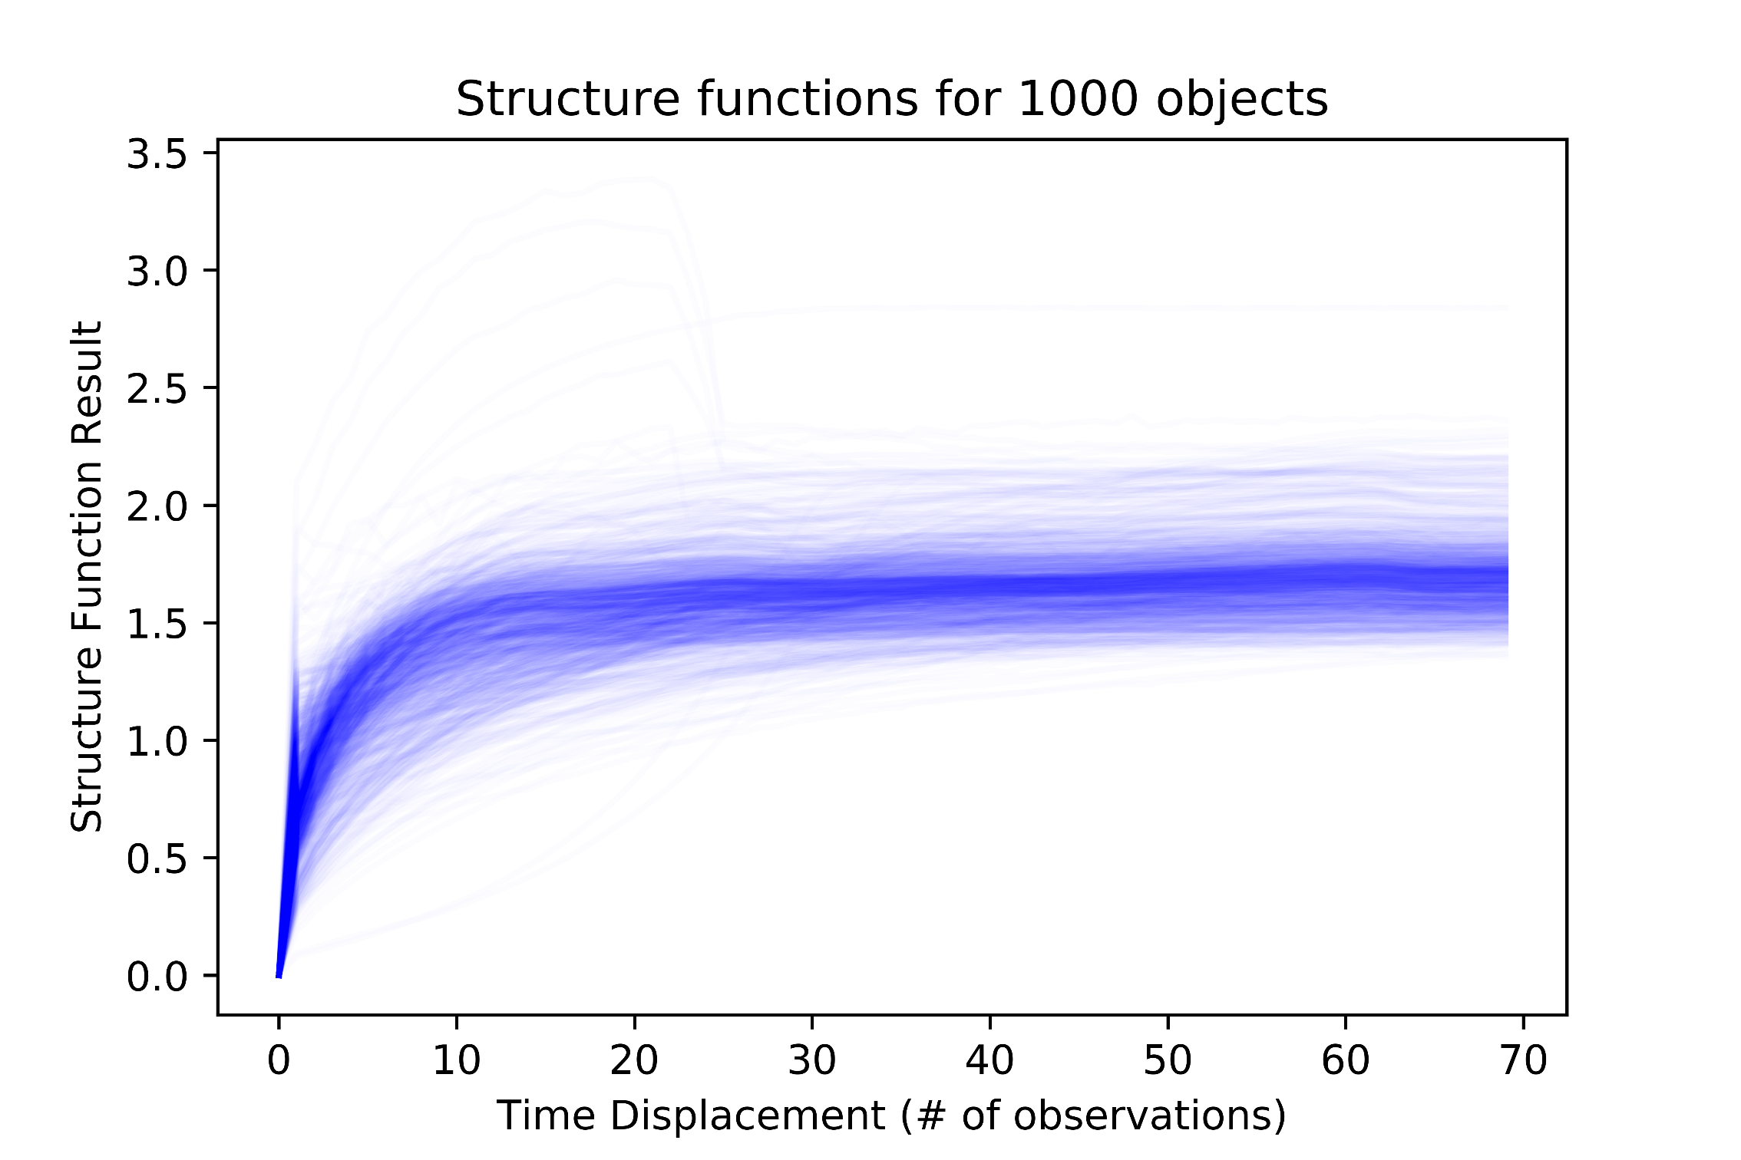
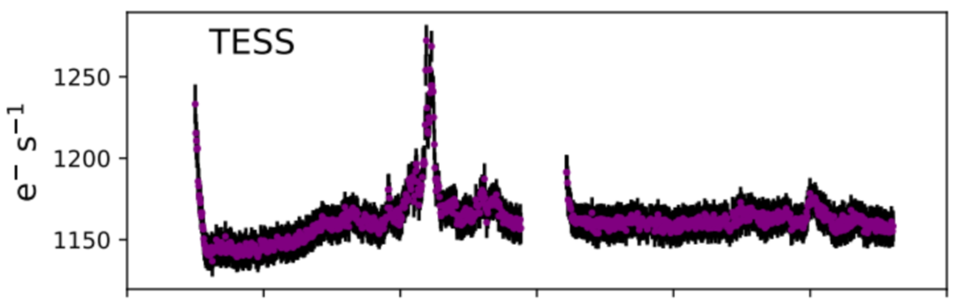
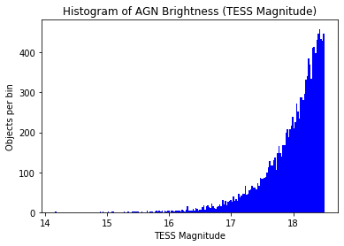
Conducting a Variability Study of Active Galaxies Using Machine Learning
Alex Evitt and Elizabeth Sellers
Academy of Science
OVERVIEW
TESS LIGHTCURVE DATA
SLOAN DIGITAL SKY SURVEY DATA
MODEL FINDINGS
The first, and biggest, part of our project was the data creation. TESS is brand new, and thus there are not many light curves, especially not any AGN light curves, so we had to invent methods to create our own. Then, all of those light curves go through a time sensitive machine learning model (a long short-term memory recurrent neural network). From this we can gleam properties of supermassive black holes at the center of galaxies, confirming or redefining the current accepted model of AGNs.
TESS (Transiting Exoplanet Survey Satellite) records data by taking images of large sections of the night sky. It looks at each section, called a sector, for one month at a time, then moves on to the next sector. At places where sectors overlap near the poles, objects are viewed for months at a time. This gives longer light curves which is more beneficial for machine learning models, so the AGN dataset was cut based on the number of sectors in which objects were observed.
Model not complete.
CATALOGUE CREATION
CONCLUSIONS
Data was taken from a Gaia catalogue of high accuracy active galactic nuclei, which was cross referenced with an allWISE catalogue. Below is a map of all the objects in this catalogue colored corresponding to the number of sectors that TESS observed them in. The south pole has been seen in the most sectors because that is where there is much sector overlap and TESS is currently collecting data from the northern hemisphere.
Model not complete.
Below, in red, is a light curve made for blazar 3C 120. A blazar is a type of AGN. Under it is the same blazar but made using a data processing pipeline created by astrophysicist Krista Lynne Smith, who recently has shared some techniques with us to improve our methods. The fact that the two light curves clearly show the same trends is encouraging.
This histogram highlights a problem with the dataset. It indicates that most of the AGNs in the catalogue are about 2000 parsecs from earth, as in within the Milky Way galaxy. Active galactic nuclei are, in fact, separate galaxies, and they would be expected to be seen at much greater distances. TESS may not be measuring these distances accurately; because most of the objects it sees are stars that would be expected to be seen within this range, it may be interpolating inaccurate distances, but it still throws a wrench in the accuracy of the dataset.
CLASSICAL ANALYSIS

